Slide 1
Objectives Cell Membrane
Understand how the cell membrane is built and helps a cell maintain homeostasis.
Identify the ways the cell membrane restricts &/or controls the movement of substances in and out of the cells.
Identify types of membrane proteins.
List the functions of membrane proteins.
Vocabulary
Phospholipid
Lipid Bilayer

Slide 2
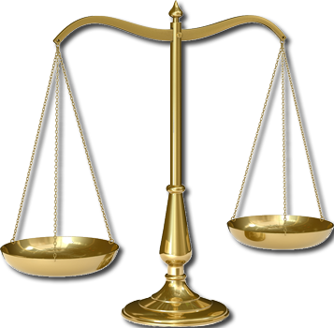
Inside our Bodies
The process of any organism trying to maintain balanced, stable internal conditions in a changing environment is called homeostasis.
It’s natures balancing act done because the world always changes.
What about inside our bodies?
How does our internal environment change?
What about the concept of dehydration?
What do you do to fix this?
How do you know to do this?

Slide 3
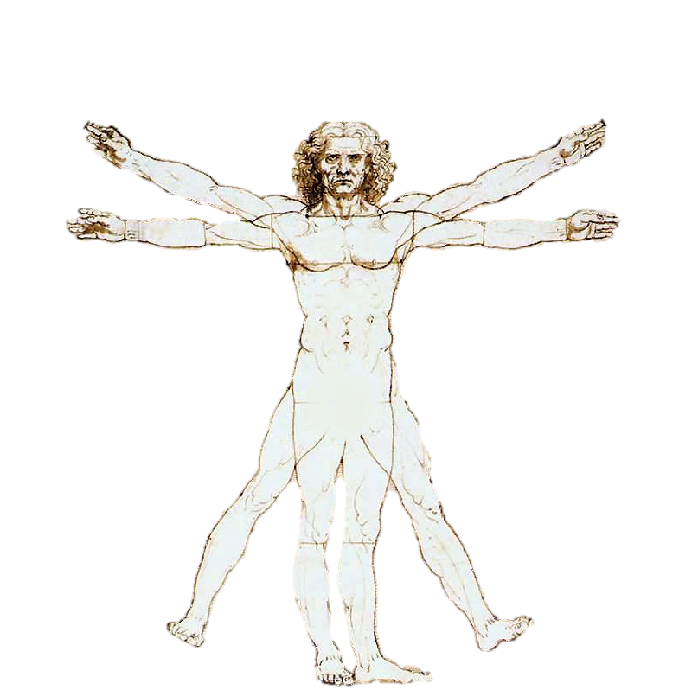
Homeostasis
Being thirsty is a chemical solution to satisfying our body’s need for water.
As our water levels change in our bodies we have to adjust these to be as healthy as possible.
This is just one reaction that takes place in our bodies but all living things react to their environments.
These reactions help organisms maintain homeostasis.

Slide 4
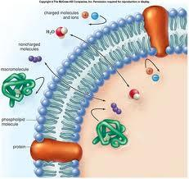
Homeostasis, continued
Individual cells, as well as organisms, must maintain homeostasis in order to live too.
One way that a cell maintains homeostasis is by controlling the movement of substances across the cell membrane.
In our continued study of cells, we are going to focus on how cells maintain homeostasis by the properties of the cell membrane.

Slide 5
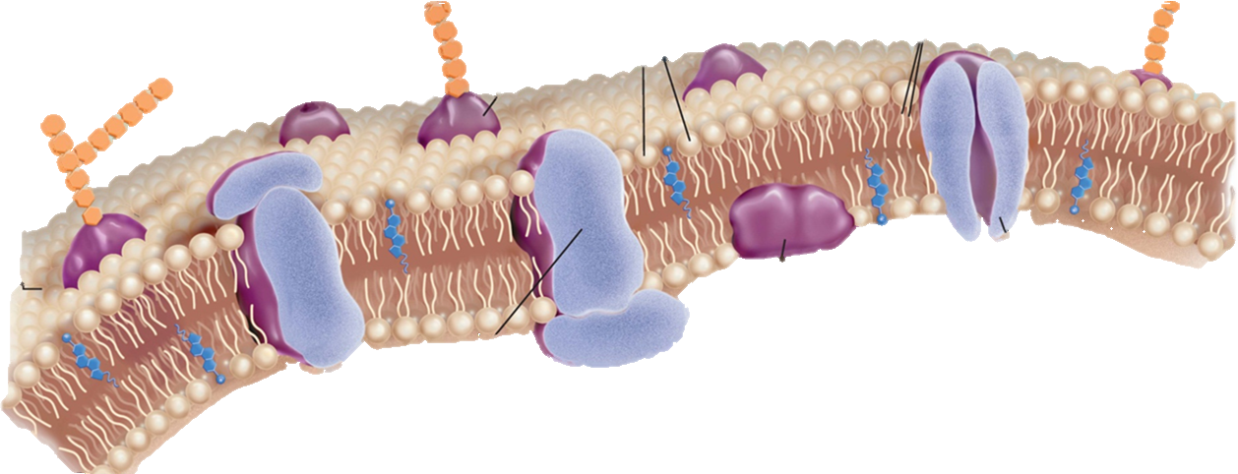
The Cell Membrane

Slide 6
Homeostasis
What are the four functions that the cell membrane performs to maintain homeostasis?
Regulates what goes in and out of the cell.
Acting as a gate keeper
To provide structural support.
Provides pressure against the internal environment
Recognizes foreign material.
Uses ‘feelers’ called receptors to identify good and bad stuff in the immediate area
Communicates and organizes with other cells.
Uses the ‘feelers’ and glycoproteins to organize with other cells into tissues forming the Extra Cellular Matrix (ECM)

Slide 7
Cell Membrane Construction
The cell membrane is made of phospholipids.
Phosphate
Polar
Head
A phospholipid is a specialized lipid made of a phosphate “head” and two fatty acid “tails.”
It is a lipid that contains phosphorus and that is a structural component in cell membranes.
The phosphate head is polar and is attracted to water.
The head is water ‘loving’ = HYDRO - PHILIC
The fatty acid tails are nonpolar and are repelled by water.
The tail is water ‘hating’ = HYDRO - PHOBIC
Fatty-Acid
Non-polar
tails

Slide 8
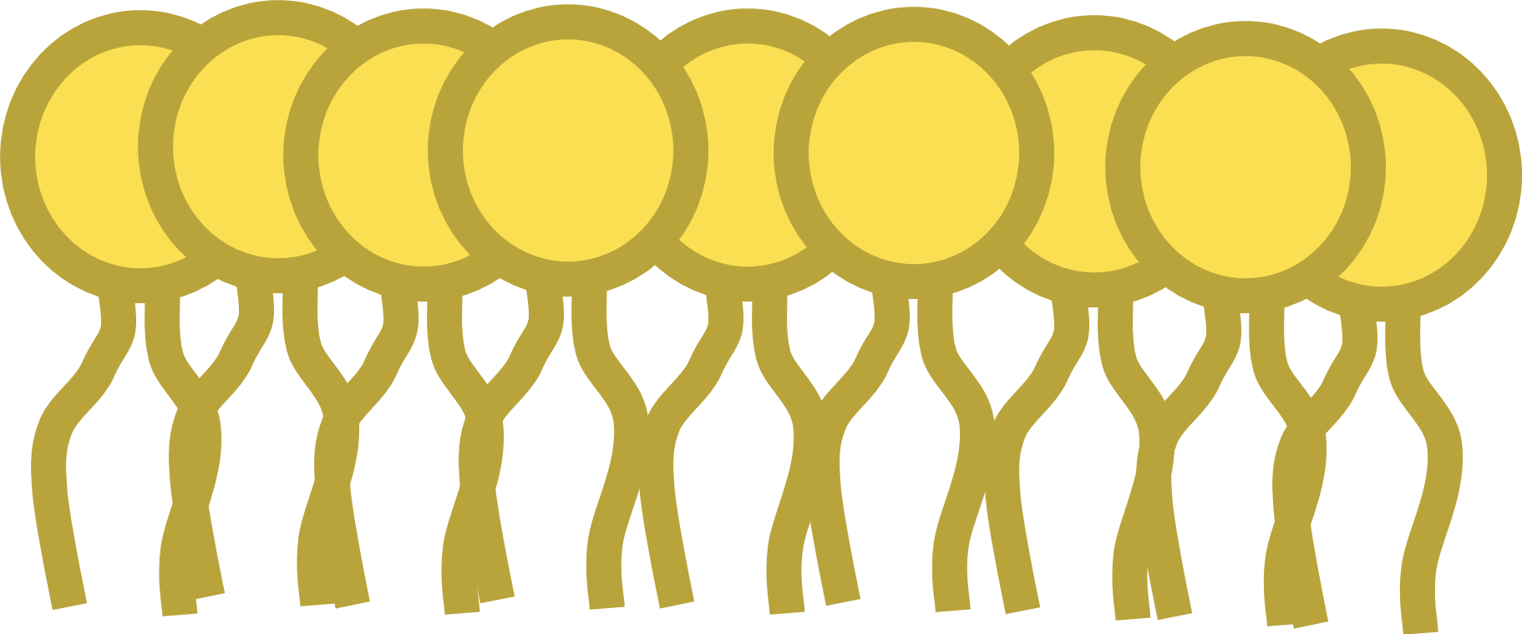
Phospholipid
WATER REGION
Polar Heads are HYDROPHILIC
They love water
Made of phosphates
Hydrophilic
Heads
Tails are HYDROPHOBIC
They hate and are afraid of water.
Made of fatty acids
Hydrophobic
Tails
NON- WATER REGION

Slide 9
Visual Concept: Cell Membrane
Outside of Cell
Inside of Cell

Slide 10
Cell Membranes, a.k.a. Lipid Bilayer
Structure
The basic structure of a biological membrane is composed of two layers of phospholipids
Because there is water inside and outside the cell, the phospholipids will naturally form a double layer called the lipid bilayer.
The nonpolar tails, repelled by water, make up the interior of the lipid bilayer.
The polar heads are attracted to the water, so they point toward the surfaces of the lipid bilayer.
One layer of polar heads faces the cytoplasm
The other layer is in contact with the cell’s immediate surroundings outside.

Slide 11
Lipid Bilayer

Slide 12
Visual Concept: Lipid Bilayer

Slide 13
Lipid Bilayer: Selectively Permeable
Barrier: Selectively Permeable
Selective = actively chooses among variables
Permeable = can allow things to pass through
Because of the properties of the phospholipids,
The cell membrane will allow only select molecules directly through.
Only small, nonpolar substances can pass.
This feature makes the membrane SELECTIVELY PERMIABLE, or allowing only SELECTED substances to cross into the cell.
This is also called “semi=permeable”
Ions and most polar molecules are repelled by the nonpolar interior of the lipid bilayer and therefore have to be ushered in other ways.

Slide 14
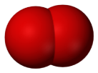
Polar Molecules, like water, are repelled by the polar heads of the phospholipid bilayer.
Other non-polar molecules, like carbon dioxide or oxygen, are not repelled and allowed to flow through the bilayer.
Because they are …
NONPOLAR.

Slide 15
Membrane Proteins
Since getting things in and out of the cell helps maintain homeostasis & not everything can freely pass through the membrane, there has to be a way for polar & large molecules to get into the cell.
Homeostasis is also helped out by various proteins that can be found in the cell membrane.
Some proteins face inside the cell, and some face outside. Other proteins may stretch across the lipid bilayer and face both inside and outside.
Proteins are made of amino acids. Some amino acids are polar, and others are nonpolar.
The attraction and repulsion of polar and non-polar parts of the protein to water help hold the protein in the membrane.

Slide 16
Membrane Proteins
What are the 3 major types of membrane proteins?
Peripheral Proteins: these are buoyed to the surface of the membrane.
Usually are associated with integral type proteins.
Integral Proteins: these penetrate into the hydrophobic regions of the membrane
Cell surface markers: glycoproteins are proteins with attached sugar chains. These chains of sugars (remember polysaccharides and carbohydrates) act as markers to help identify themselves to other cells
Receptor proteins: these are the ‘feelers’ that identify good and bad substances in the environment
Enzymes: catalyze reactions that happen on the inside of the cell
Transmembrane Proteins: these span from outside to inside the cell.
Transport & Channel Proteins: allow large and/or polar substances to pass through the membrane

Slide 17
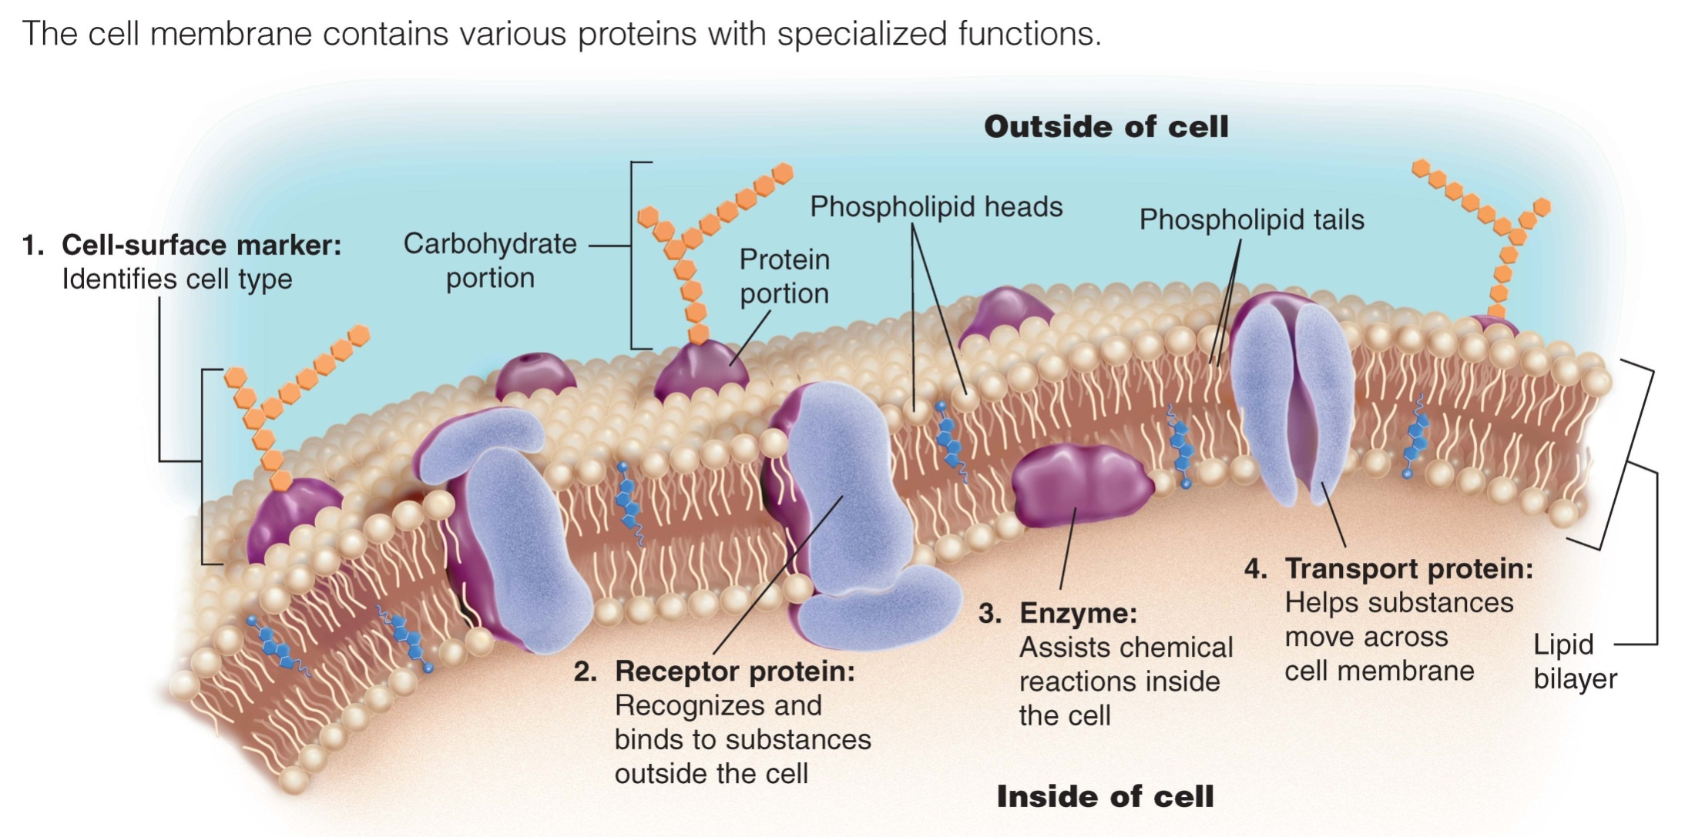
Membrane Proteins: Examples.
Membranes have numerous types of proteins that perform many different functions.
These fall into the 3 categories: Peripheral, integral, and transmembrane proteins.
Which, illustrated below, is which?
Transmembrane/Integral
Transmembrane/Integral
Integral
Peripheral
Integral
FYI: All transmembrane proteins are integral proteins but not the other way around.

Slide 18
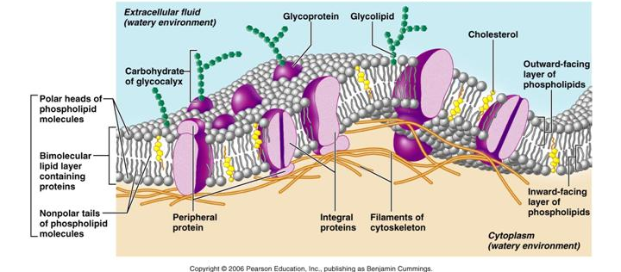
H
G
Hydrophilic Heads
F
C
Hydrophobic Tails
Transmembrane protein
E
A
B
D
Based upon what you learned, identify each of the labeled structures in the illustration. You have 3 minutes.
Word Bank:
Inside of cell
Outside of cell
Glycoprotein
Hydrophilic head
Hydrophobic tail
Peripheral protein
Integral protein
Transmembrane protein

Slide 19
Fluid Mosaic Model
FLUID = Flexible
MOSAIC = Multiple components forming it.
The cell membrane isn’t rigid.
It has the ability to be squeezed and move around.
And the same proteins are embedded throughout this squishy membrane.
This is called the Fluid Mosaic Model of the membrane.

Slide 20
Summary
One way that a cell maintains homeostasis is by controlling the movement of substances across the cell membrane.
The lipid bilayer is selectively permeable to small, nonpolar substances.
Proteins in the cell membrane include cell-surface markers, receptor proteins, enzymes, and transport proteins.

Slide 21
Discussion/Reflection
Answer the following questions:
Identify the 4 functions of the cell membrane that allows it to maintain homeostasis
If I said the cell membrane is like a “gatekeeper” what does that mean?
How does the membrane regulate things going in or out of the cell? What is that property called?
What type of molecules can go directly through? Cannot go through?
What are the 3 types of proteins within the cell membrane and describe the structure/function of each of them.

